Slide 1
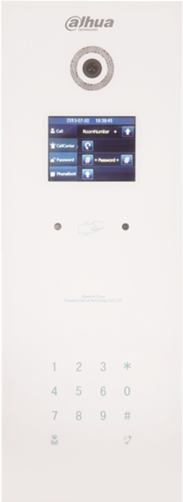
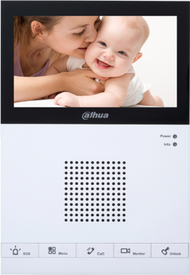
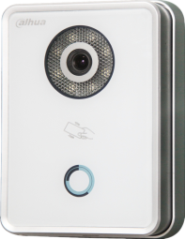
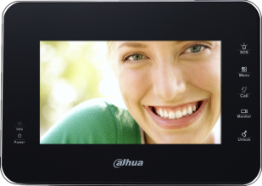
Video Intercom Operation
---2015

Slide 2
Component
VTNS1060A—provide power for VTH and villa VTO
VTNC3000A-provide power for 2-wire devices
Outdoor Station
VTO
Indoor Monitor
VTH
Network controller
VTN
Accessories
Power supply
DC12V1A– VTO/VTH
DC24V2.5A—VTNS1060A/VTNC3000A
VTH– Standard, no need to order again
VTO—Flush mounted & Surface mounted box optional

Slide 3
Technical/ IP
Connection
Upgrading
FAQ
1. Apartment system
1 VTO × multi VTH
PC
VTO1210A-X
IP 192.168.1.110
①
102
Press room No. 101
VTH1550CH
Room No. 101
IP 192.168.1.103
101
VTH1560BW
Room No. 102
IP 192.168.1.202
②
102
VTH1
VTH2
Apartment
Notes:
IP apartment system-----VTO & VTH & network switch in the same local network
PS： if choose normal switch, you should provide power supply to VTH directly

Slide 4
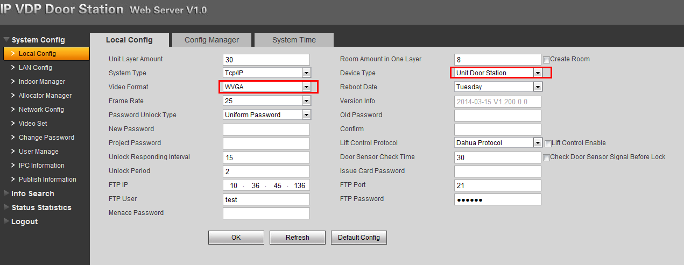
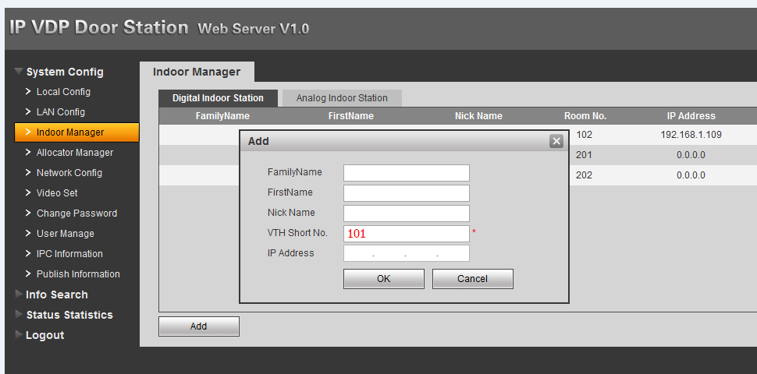
VTO ---web Setting
1）- local config
>Check Video Format as “WVGA”
>Check Device Type as “Unit Door Station”
2)-Indoor Manager
>Add VTH’s Room No. for example:101、102

Slide 5
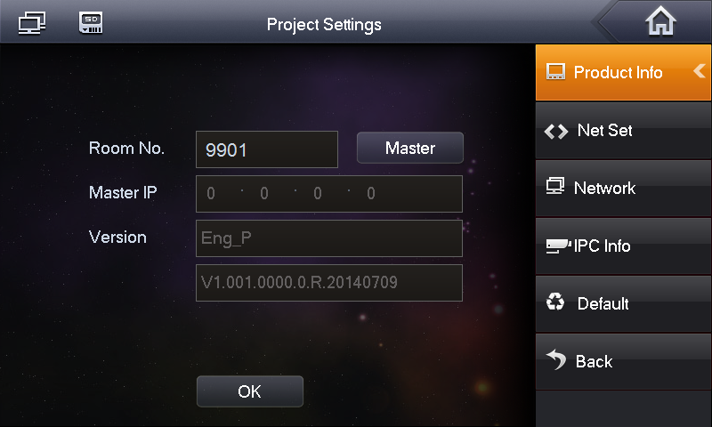
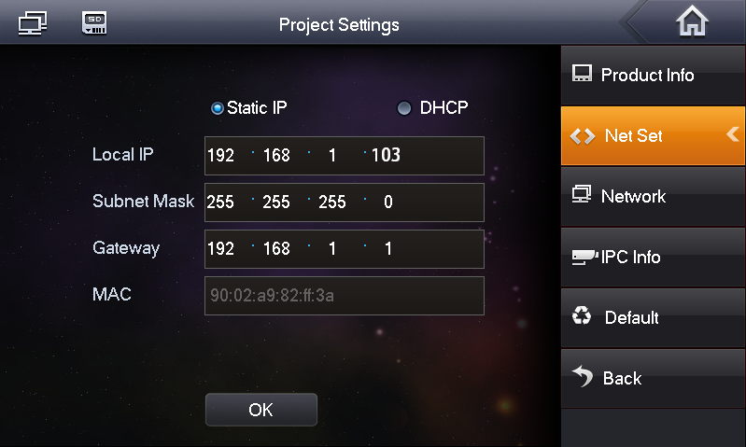
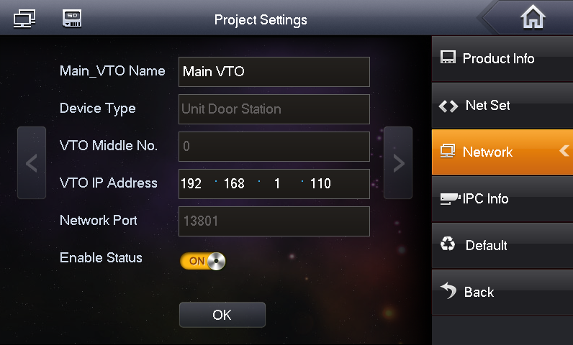
VTH Setting
1）-Room No.101
2）-IP192.168.1.103
3）-Add VTO IP：192.168.1.110

Slide 6
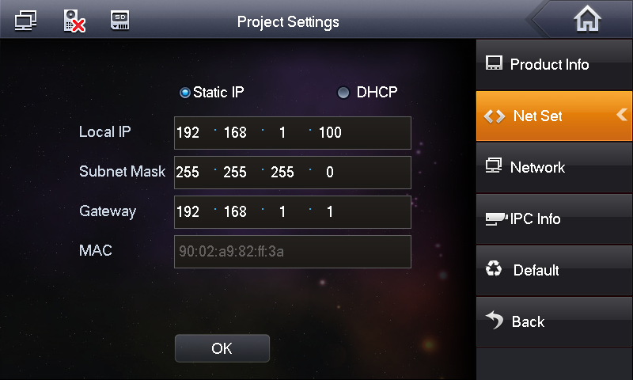
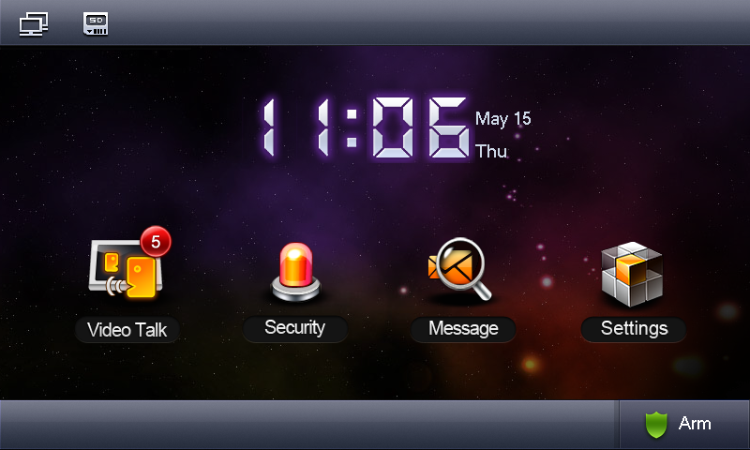
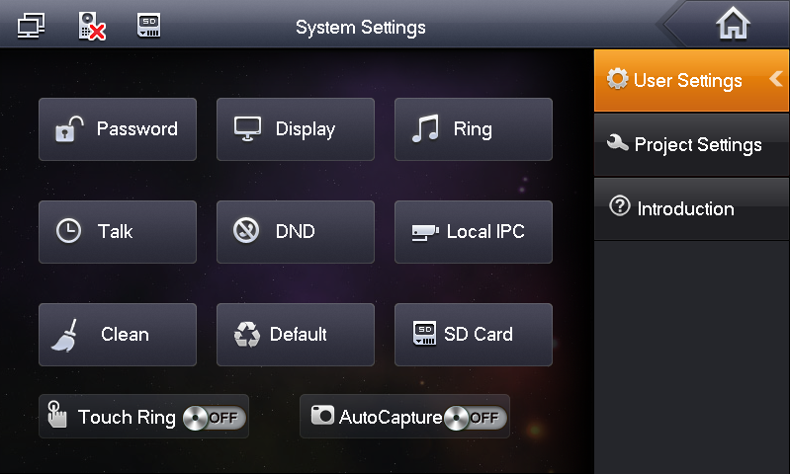
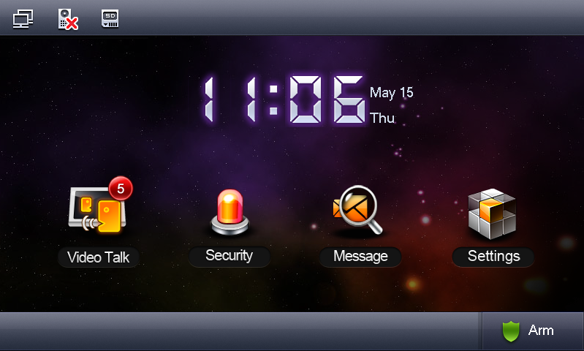
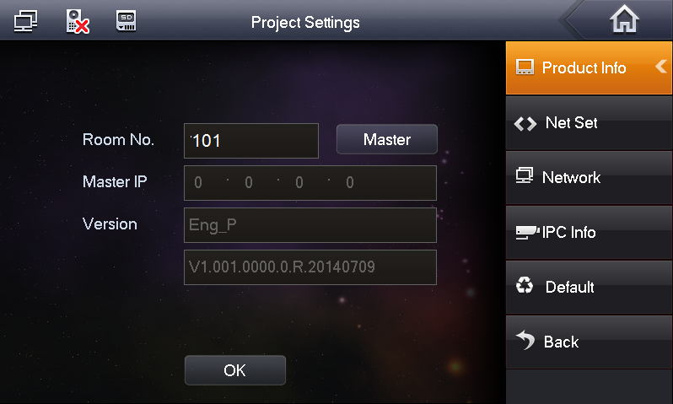
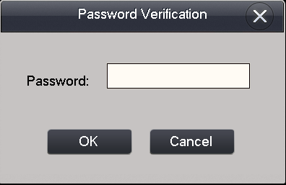
Connect with VTO Successfully
1-Input VTH’s Room No.
002236
2-Input VTO’s IP
3- Enable

Slide 7
Technical/ IP
Connection
Upgrading
FAQ
2. Villa system
1 VTO × max 5 VTH
（Group Call）
PC
VTO2000A
IP 192.168.1.110
①
Villa—one button to call group
*unit—Press Main VTH’s room No. 9901
VTH1550CH
Room No. 9901
IP 192.168.1.103
9901
VTH1560BW
Room No. 9901-1
IP 192.168.1.202
②
-1
Main VTH
Extension VTH
Villa
Notes:
Group Call----set mutli VTHs(max 5 pcs in the same group), when VTO call the group No.( it is the main VTH’s Room No.), all VTHs in the same group will ring together.
PS :Both IP Apartment system & IP Villa System can support ‘Group Call’ function

Slide 8
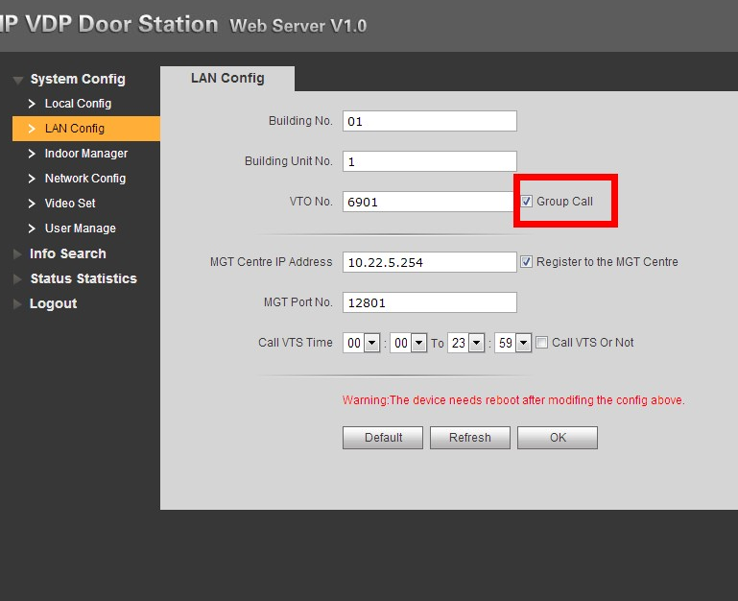
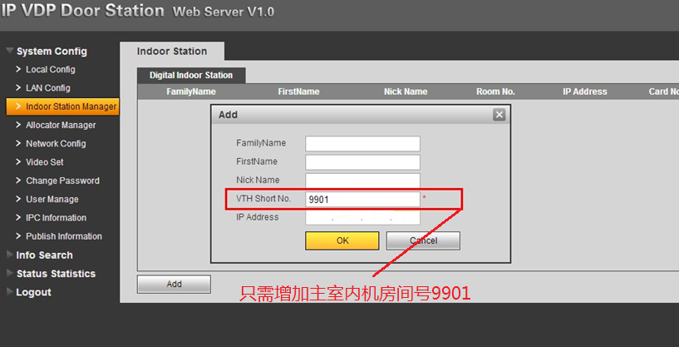
VTO ---web settings：
1）LAN Config
> check “Group Call”， reboot the device
2）Indoor Manager
>After rebooting, Add Main VTH’s Room No. 9901
Only need to input main VTH’s room number

Slide 9
Main VTH Setting
1）-Room No.101
2）-IP192.168.1.103
3）-Add VTO IP：192.168.1.110
Notes:
1- Main VTH settings is same as the page 5. Here should note the extension VTH’s setting

Slide 10
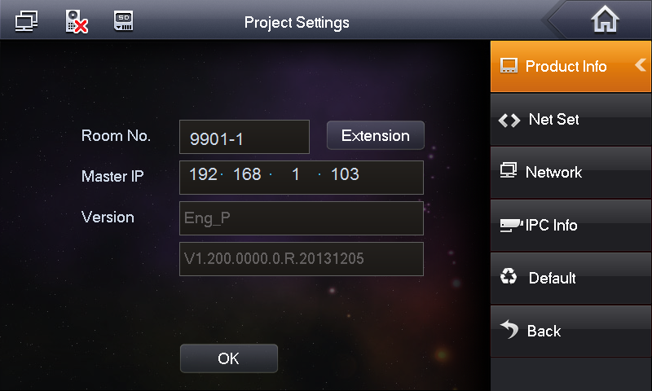
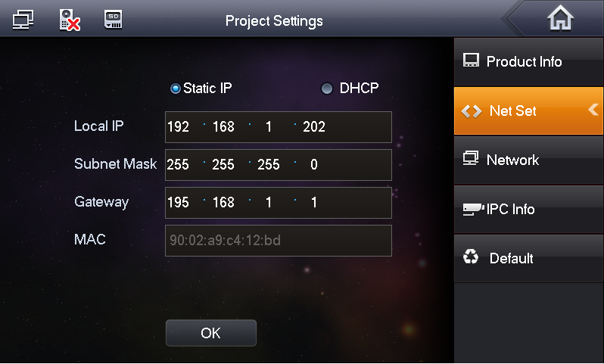
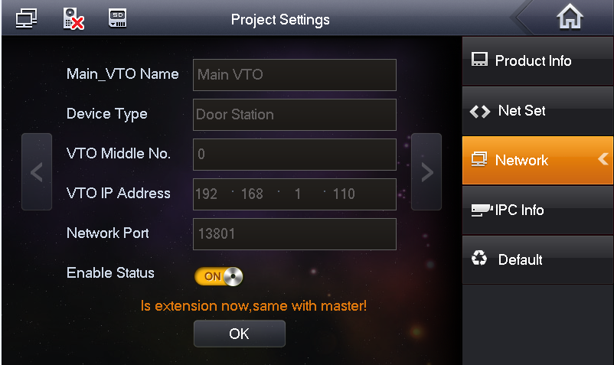
1-Choose it as Extension
Extension VTH Setting
1)-Room No. 9901-1
Input Main VTH’s IP 192.168.1.103
2)-set its IP：192.168.1.102
PS：No need to add VTO’s IP address
2- Input Extension VTH Room No.
3-Input Main VTH’s IP address
Notes:
Make sure all the devices are in the same network

Slide 11
Technical/ IP
Connection
Upgrading
FQA
3. Sub VTO setting
Max 20 VTO × 1VTH
PC
VTO1210A-X
IP 192.168.1.110
VTH1550CH
Room No. 9901
IP 192.168.1.103
DC12V
①
Main VTO
Press Room No. 9901
②
VTO2000A
IP 192.168.1.111
Villa –one button to call VTH
*Unit-press the VTH’s room No,. 9901
Sub VTO
Notes:
Main VTO and Sub VTO----you can choose the VTO’s module as you want

Slide 12
Main VTO/Sub VTO ---web setting：
1）Add the VTH’s Room No. on the Main VTO and Sub VTO’s web
Only need to input main VTH’s room number

Slide 13
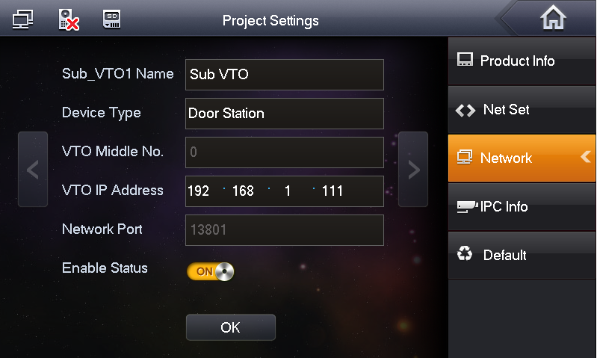
VTH’s Setting
(Settings>Project setting>Password:002236)
1)-Room No.9901
2)-IP: 192.168.1.103
3)-Network :
Main VTO IP：192.168.1.110
Sub VTO IP：192.168.1.111
Notes:
Most setting on the VTH is same as page 5, After adding Main VTO, here should press ‘>’ to add sub VTO

Slide 14
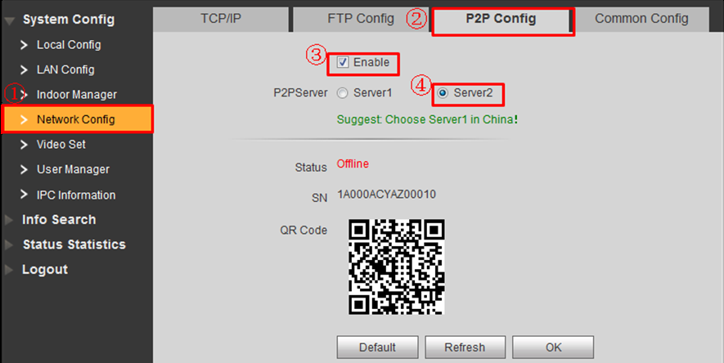
Technical/ IP
Connection
Upgrading
FQA
4. Mobile APP(DMSS, Only for Villa )
VTO setting
1)Make sure there is public network
2)LAN config> Network config
DNS address default is 8.8.8.8, it can be changed as local DNS
P2P Config>check ‘Enable’, choose ‘ Server 2’
PC
P2P
VTO2000A
IP 192.168.1.110
VTO
Public network
VTH1550CH
Room No. 9901
IP 192.168.1.103
VTH
Villa
Notes:
Please note that right now, DMSS only can be used in Villa System

Slide 15
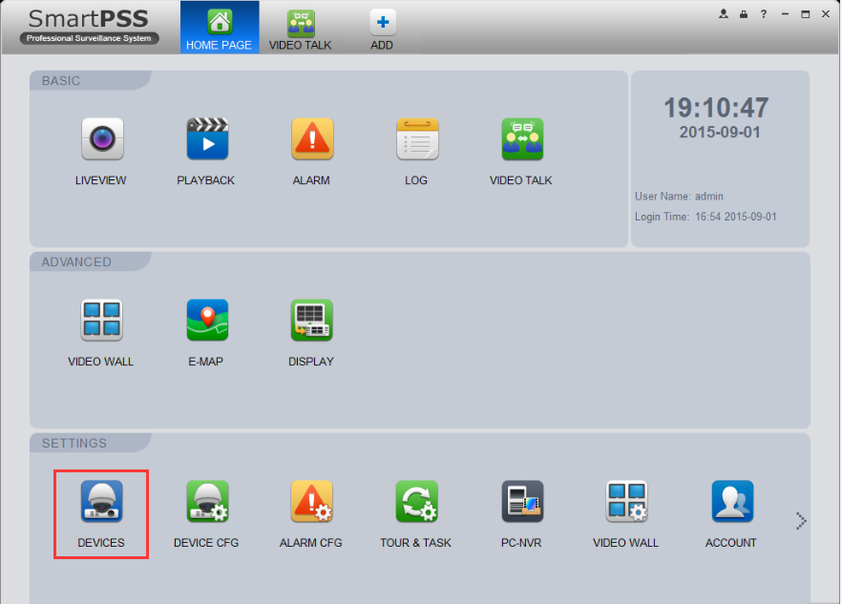
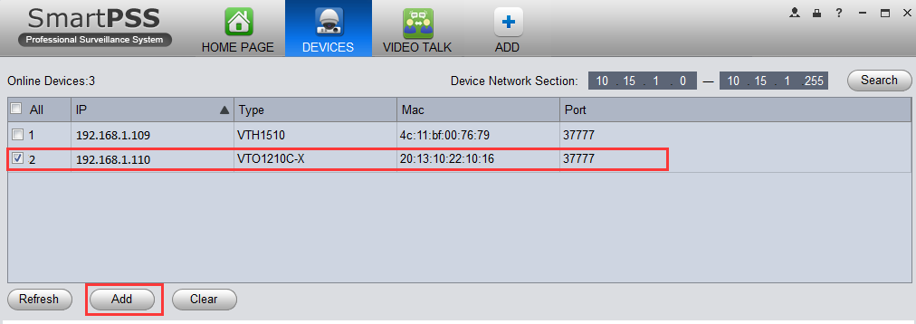
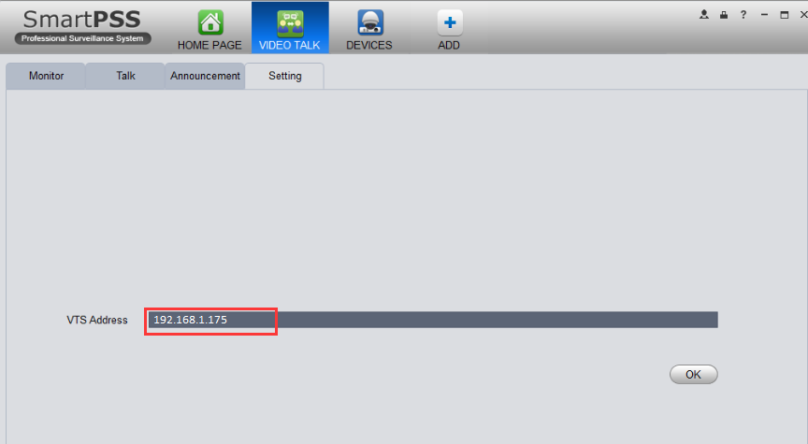
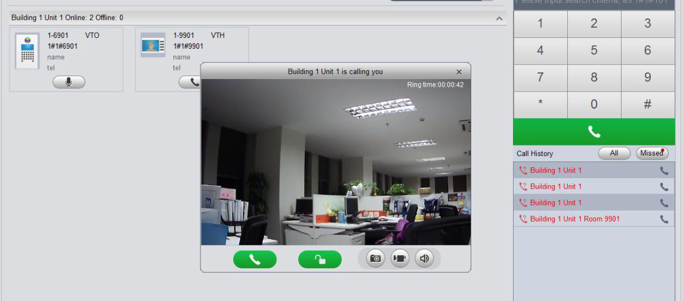
Technical/ IP
Connection
Upgrading
FQA
SmartPSS setting 1) Check Settings>Device, Search the device in the same local network, add the VTO as you want.
2)There is no need to add VTH, it will be online automatically when VTO added
3) Check Video Talk> setting, input PC’s IP
4) Check Talk, here will show the device’s status
SmartPSS
Apartment

Slide 16
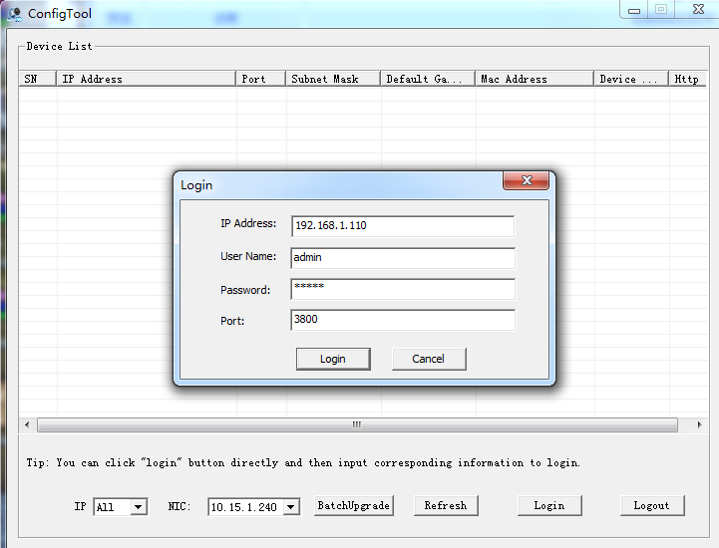
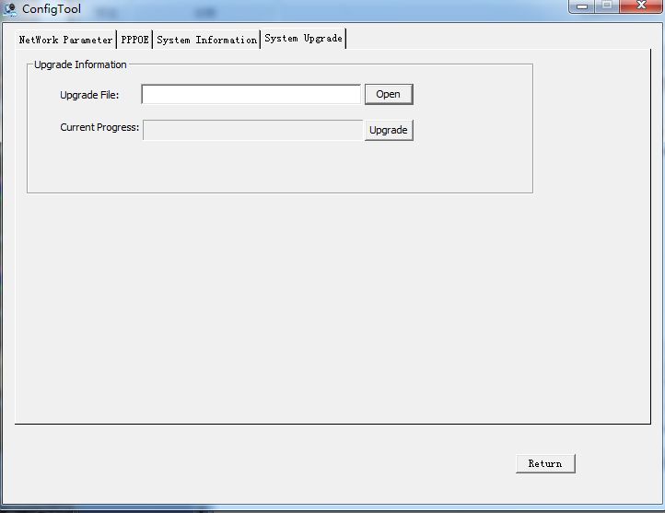
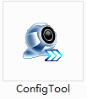
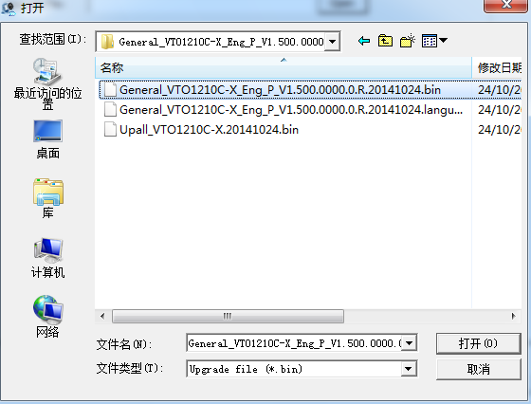
Technical/ IP
Connection
Upgrading
FQA
Tool-----ConfigTool 1.0
2. Upgrading steps（similar with IPC）
Input device’s IP address192.168.1.110
Input device’s port 3800
2. Tool-----ConfigTool 3.0
Choose the device which need to upgrade
Check ‘login’
Note : it should use port as 3800 when you upgrading the software between 'General' and ' Multi'

Slide 17
Technical/ IP
Connection
Upgrading
FQA
Q：Calling is normal, but monitor from VTH is failed
A：IP conflict, check the devices’ IP, and modify them as unique
Q: VTO can’t call VTH, VTH can’t monitor VTO
A：Check the device’s setting, add VTH’s Room No. on VTO‘s web, and add VTO’s IP address on VTH’s screen
Q：Group call, but VTO only can call one VTH successfully
A：Check VTO’s web setting> LAN config> choose ‘Group call’, then device should be reboot
Q：Connect successfully, but there is no video nether audio when calling
A：Generally, it is caused by software version, so need to check the device’s version first to see if they are matching or not.
Notes:
主从门口机----要实际应用要求选择型号

Slide 18
Technical/ IP
Connection
Upgrading
FQA
Q: Sub VTO can’ t call VTH successfully when there are multiple VTO
A：Check VTO’s setting>LAN config, please keep all VTO in the same building, same unit. And all the VTO’s No. should be different( such as 6901, 6902).
Q: VTO’s web interface can’t show completely.
A：Clean the history of the IE explorer.
Q: VTO/VTH is always rebooting after upgrading
A：Clean the configuration( by configtool 3.0/ by telnet command).
Q: Clean configuration by ‘ConfigTool 3.0’, Then VTO show Chinese strings on its web
A：Reboot the VTO by reconnecting the power supply , after that VTO will clean configuration successfully
Q: SmartPss support VTO’s real-time video, but the device are offline on the ‘ Talk’ table
A：Close the windows firewall.
Notes:
主从门口机----要实际应用要求选择型号

